Slide 1
CH2PH2:
Surfaces and Interfaces
Dr. James Hallett
j.e.hallett@reading.ac.uk

Slide 2
CH2PH2
Lecture 4: Liquid Crystals

Slide 3
What are liquid crystals?
“A state of matter whose properties
are between those of a regular
Liquid and a crystalline solid”
What are some properties of liquids
and crystalline solids?

Slide 4
Crystal
Liquid
(Nematic)
Liquid
Crystal

Slide 5
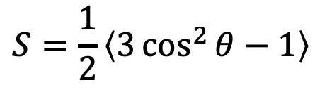
S= 1
Order parameter
n
S= 0
S ~ 0.6
$$S=\frac{1}{2}\left\langle 3\cos^{2}{θ}−1\right\rangle$$
Where theta is the angle between the molecular axis and the director n

Slide 6
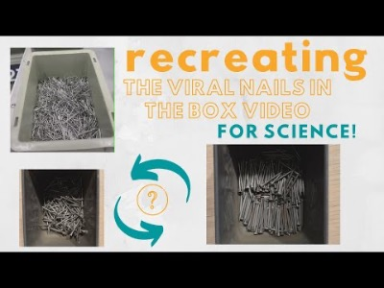
Background context
https://youtu.be/HEwGeqR4duQ

Slide 7
Second law of thermodynamics
“the total entropy of a system either increases or remains constant in any spontaneous process; it never decreases”

Slide 8
Excluded volume
Free volume
Although orientational entropy goes down (and free energy goes up) when molecules align in a nematic,
positional entropy increases (so free energy goes down).

Slide 9

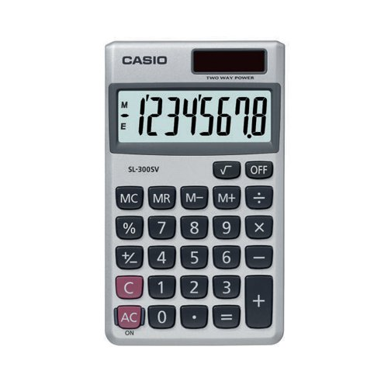
Typical liquid crystal molecules
“5CB” - 4-Cyano-4'-pentylbiphenyl
Typical liquid crystal molecules are:
“rod like”, so they form a nematic phase
have an alkyl tail so they stay liquid at room temperature
have a large dielectric anisotropy (how easy it is to polarise the molecule along the long axis versus the short axis), so they can be reoriented easily by an electric field.
Chemical innovation usually involves improving one of these properties – novel liquid crystal molecules/compositions are closely guarded secrets!
Very good for Raman
Spectroscopy!

Slide 10
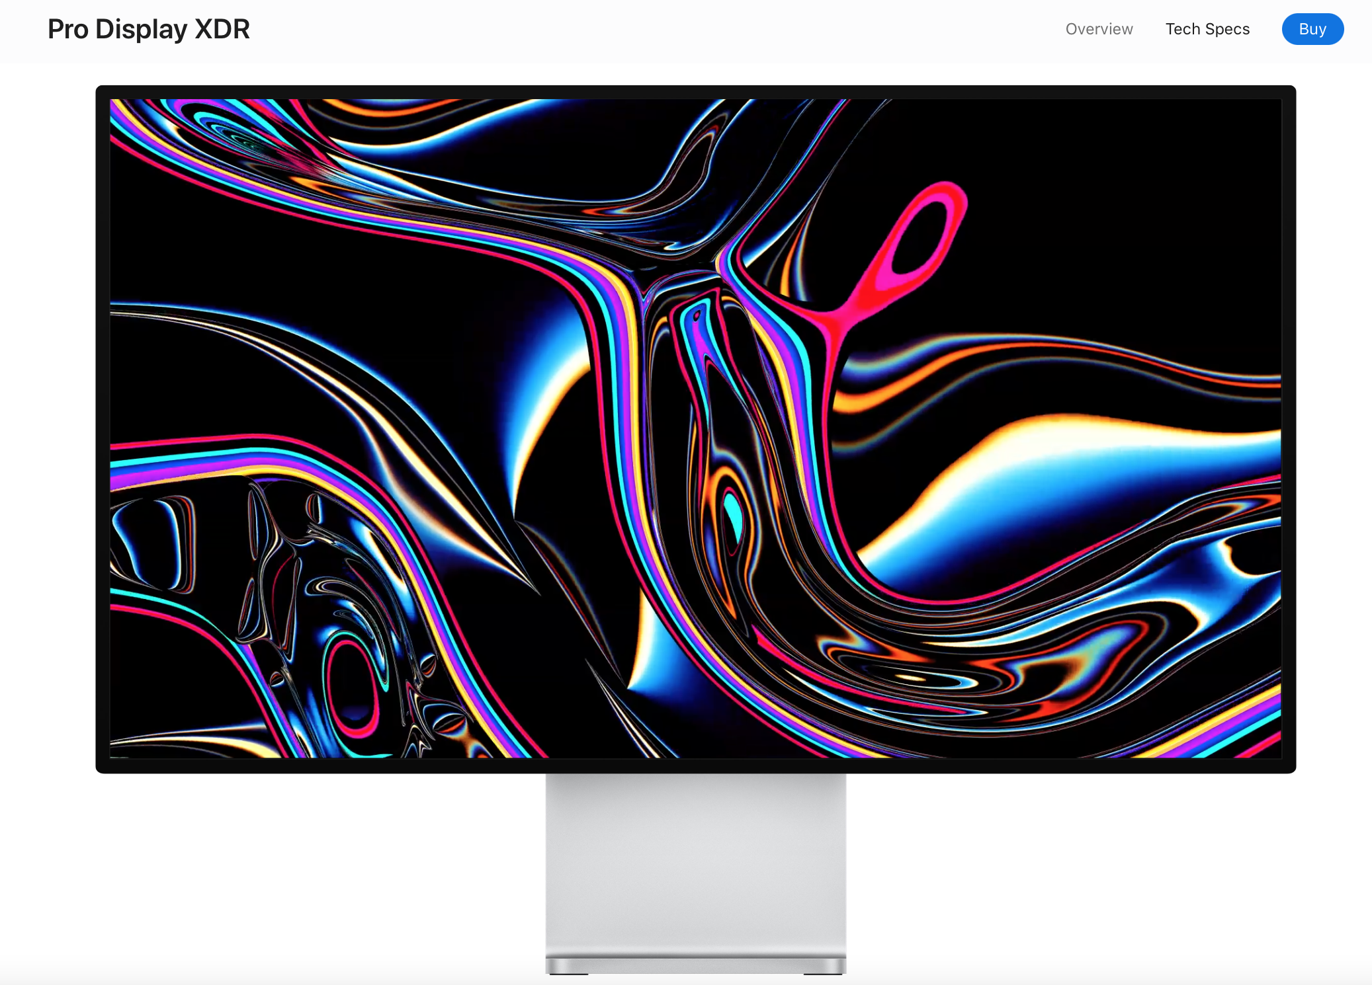
Liquid crystal displays (LCDs)
Background context

Slide 11

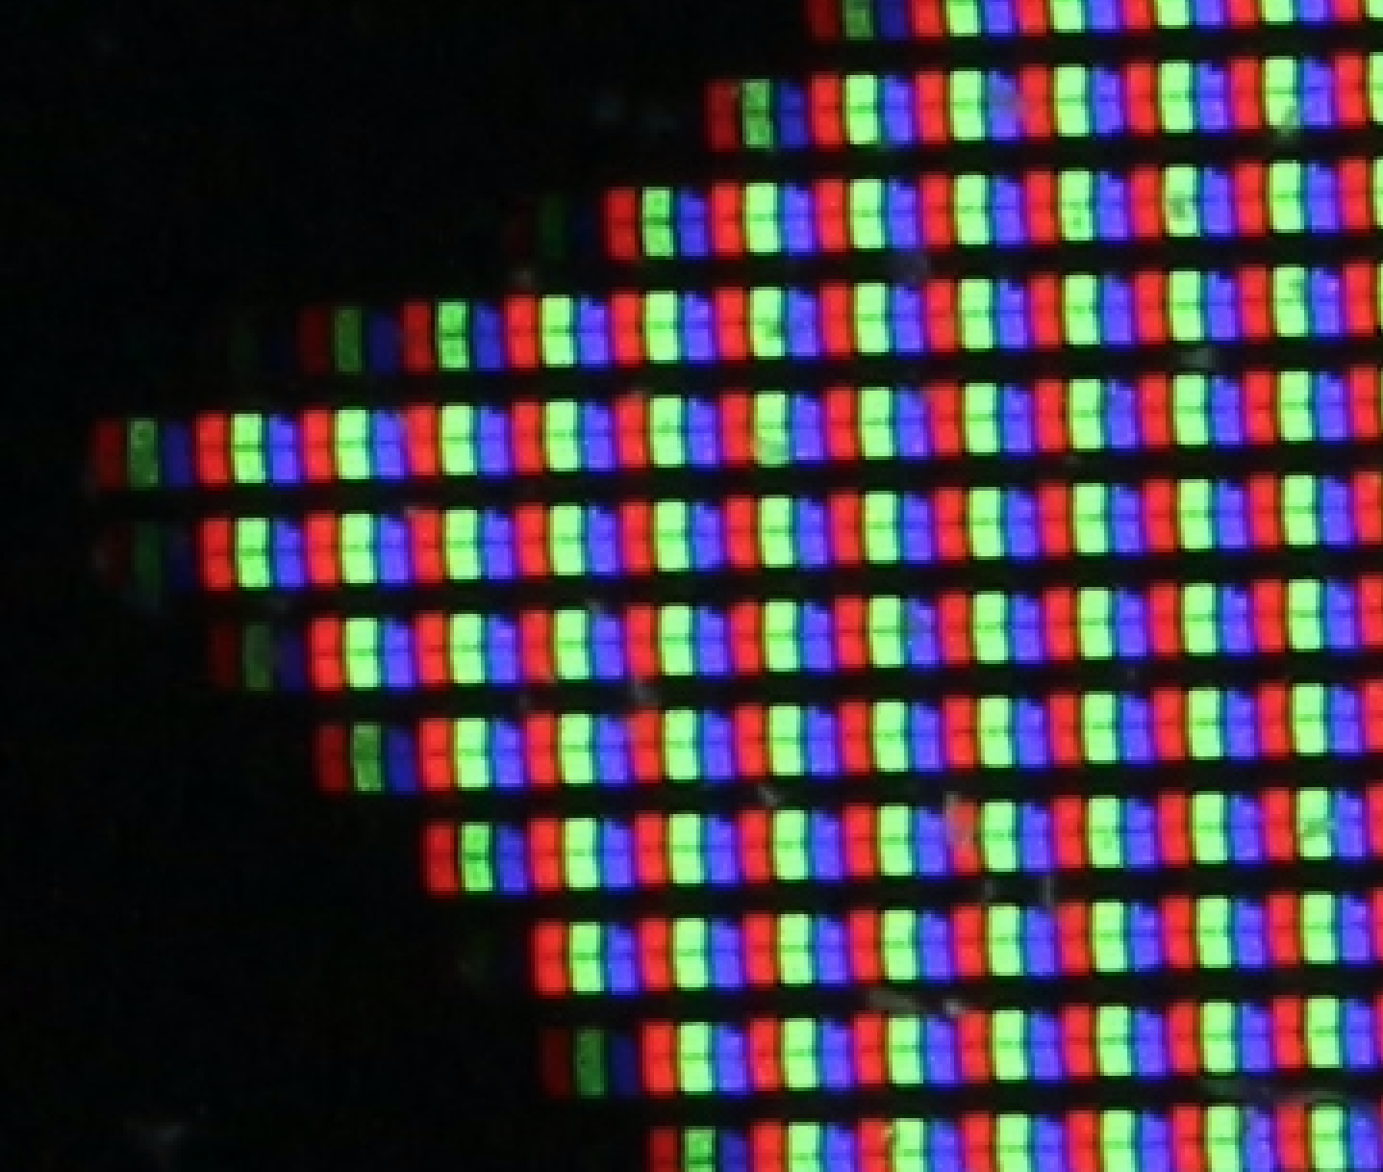
LCDs
Background context

Slide 12
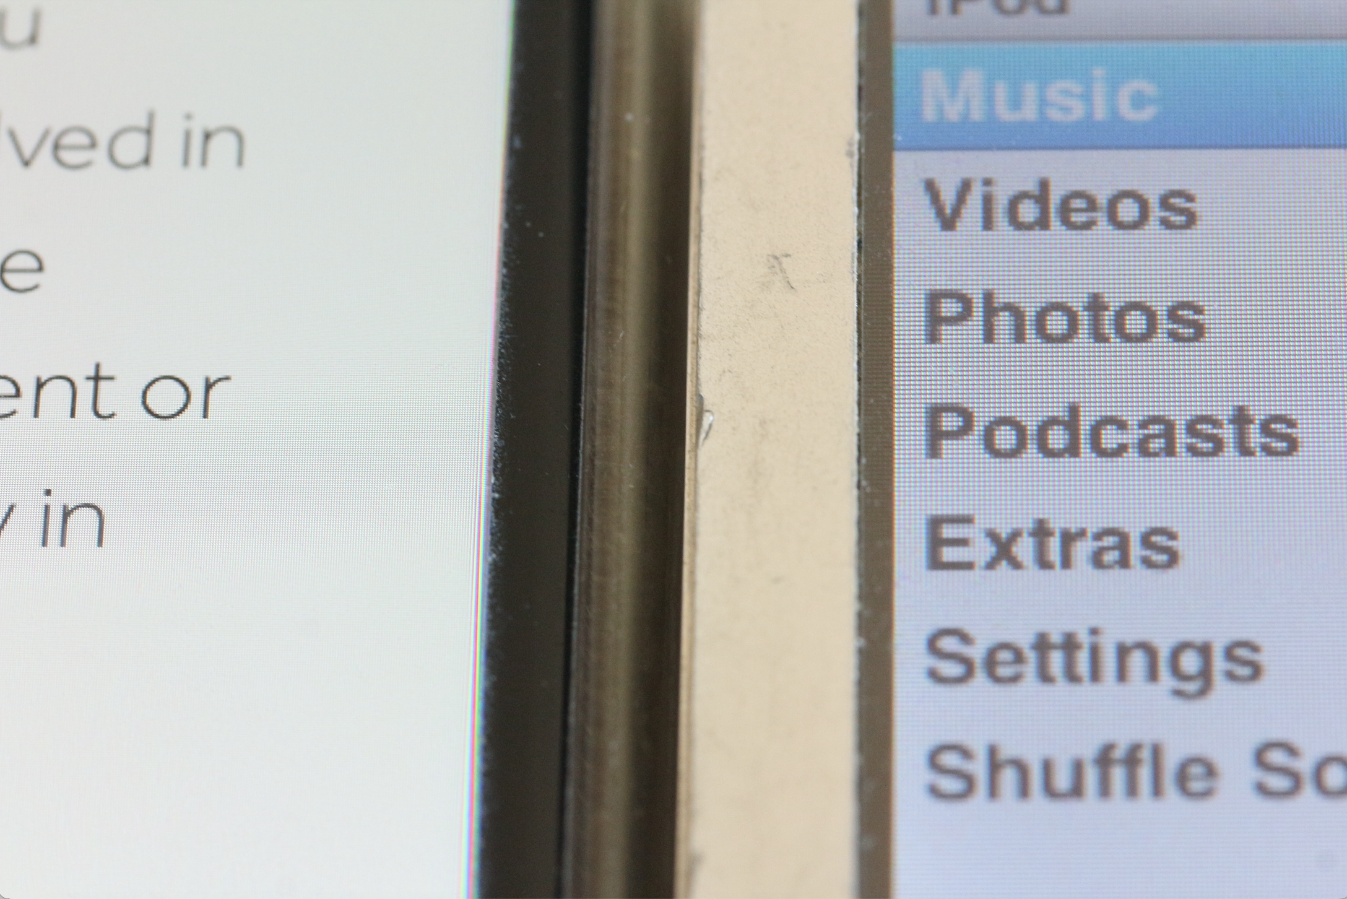
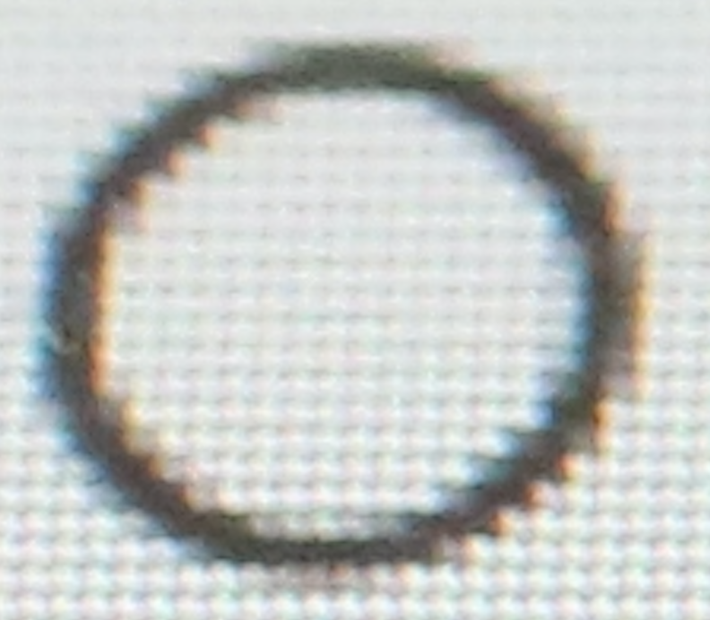
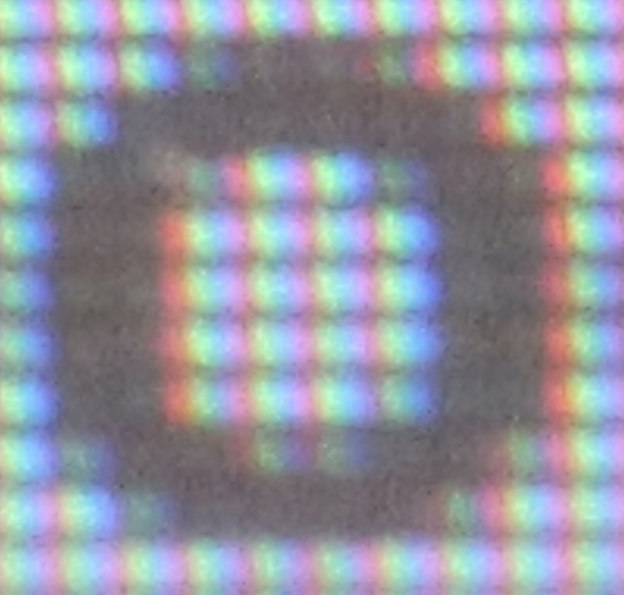
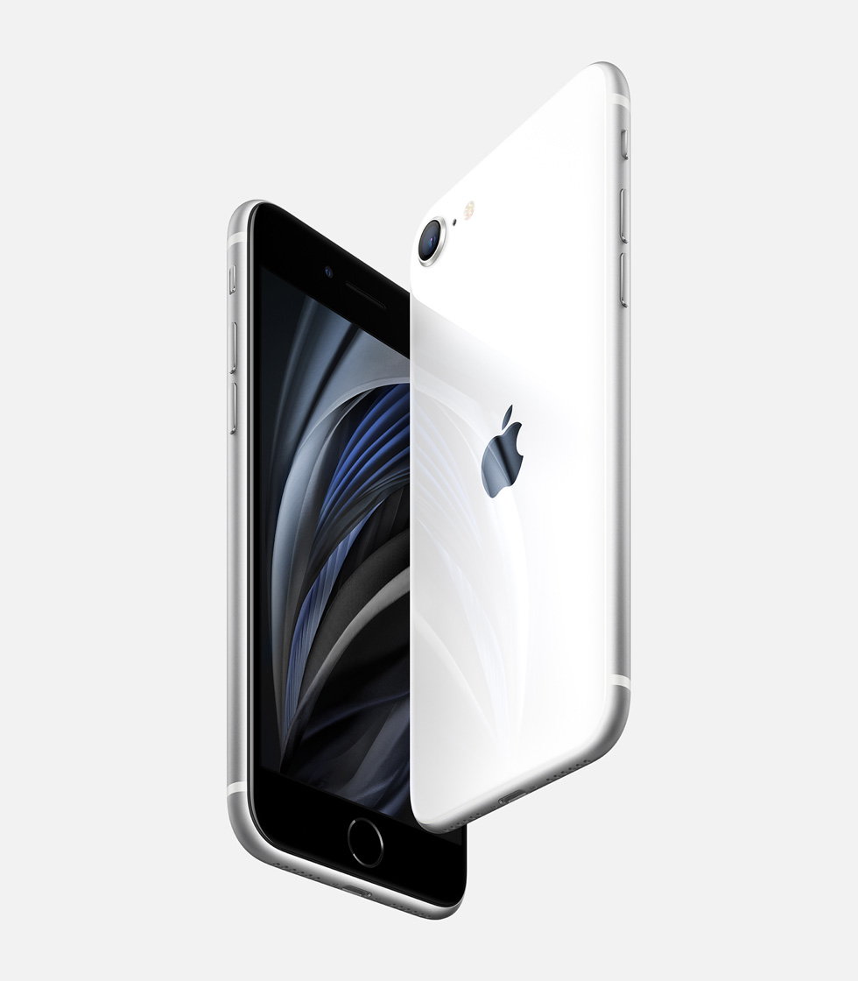

Pixel size in LCD displays
~336 ppi,
75 μm pixel size
~163 ppi,
153 μm pixel size
Background context

Slide 13
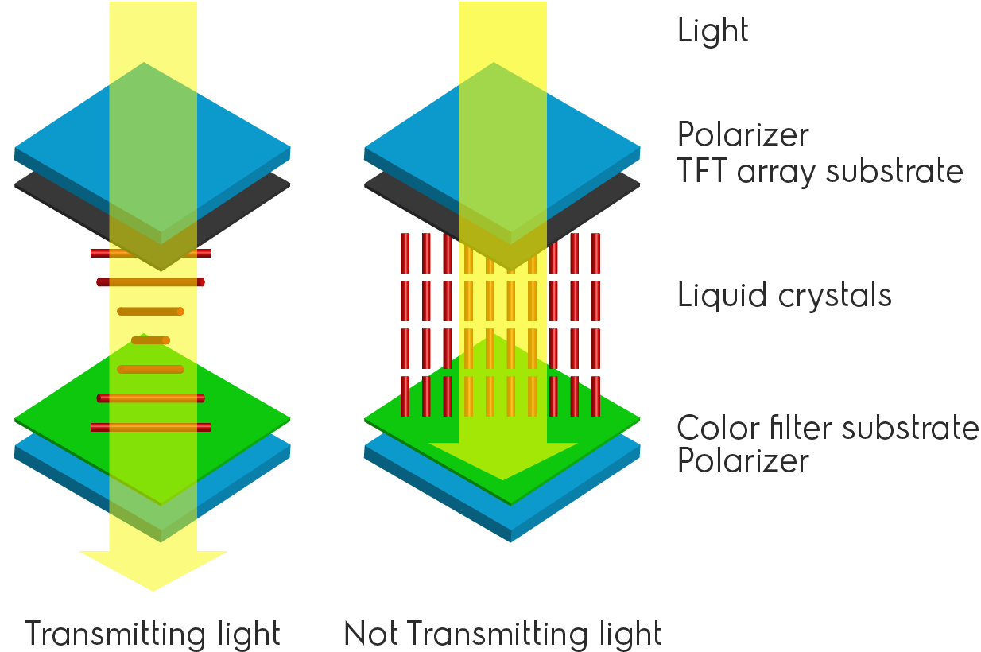
A simple LC display pixel
- - -
-
+
+ + +
Image source: pixelstrobist

Slide 14
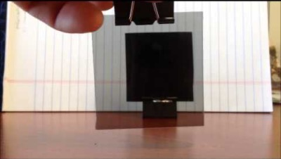
Crossed polarizers
https://youtu.be/iAILxVfHse0

Slide 15
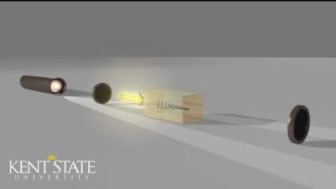
Crossed polarizers
https://youtu.be/OQiSXUfeKaQ

Slide 16
LCDs

Slide 17
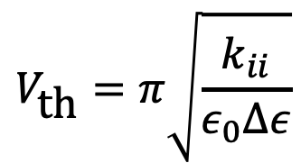
The Frederiks (Fréedericksz) Transition
The voltage required to “switch” the liquid crystal cell from one orientation to another.
Sometimes expressed as a critical electric field (V/d)
Depends on liquid crystal “elasticity” and “dielectric anisotropy” – how hard it is to bend the director to a new direction versus how sensitive it is to electric field
$$V_{\text{th}}=π\sqrt{\frac{k_{ii}}{ε_{0}∆ε}}$$
Δ𝜖 – dielectric anisotropy
𝜖₀ – permittivity of free space = 8.85 ✕ 10⁻¹² C² N⁻¹ m⁻²
K_{ii} – elastic term (varies for different geometries)

Slide 18
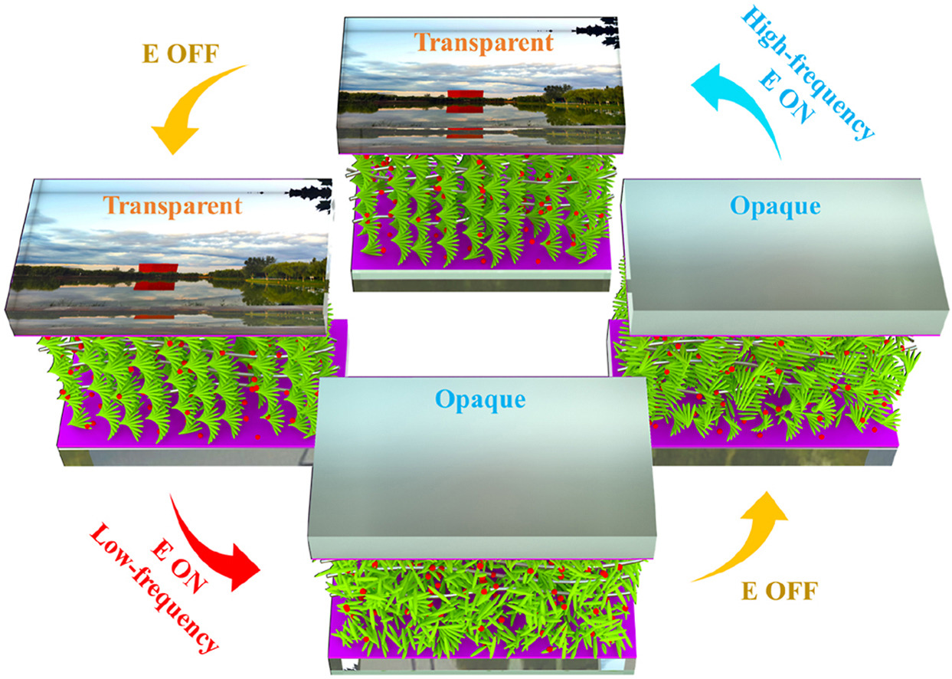
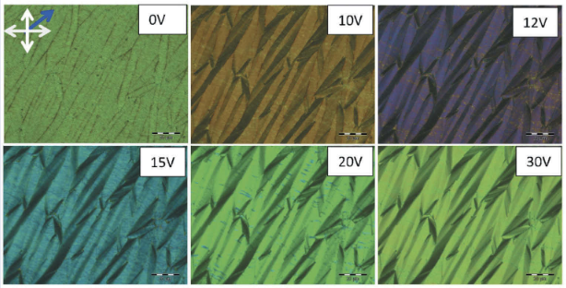
New LC technologies
Shukla, R. K., Chaudhary, A., Bubnov, A., Hamplova, V., & Raina, K. K. (2020). Electrically switchable birefringent self-assembled nanocomposites: ferroelectric liquid crystal doped with the multiwall carbon nanotubes. Liquid Crystals, 47(9), 1379-1389.
Li, X., Zhang, M., Zhang, C., Niu, R., Ma, H., & Sun, Y. (2023). A bistable ion-doped cholesteric liquid crystal smart window with a small amount of polymer. Optical Materials, 138, 113659.
“Electrochromic” change colour with voltage – no need for colour filters
“Bistable” – doesn’t use power to display an image
Background context

Slide 19
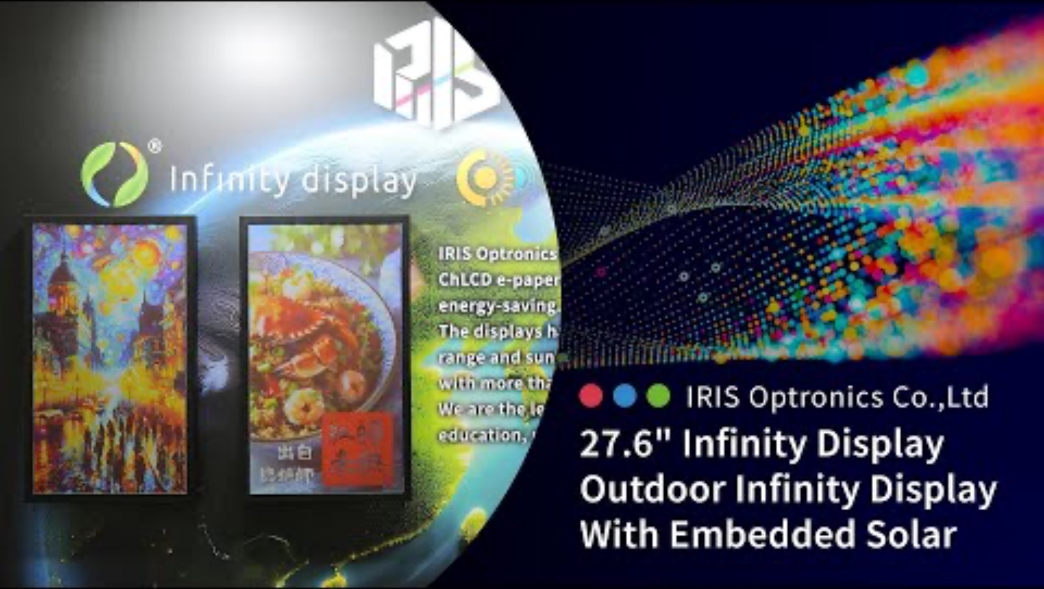
Background context
https://www.youtube.com/watch?v=WGcBtN7axYQ

Slide 20
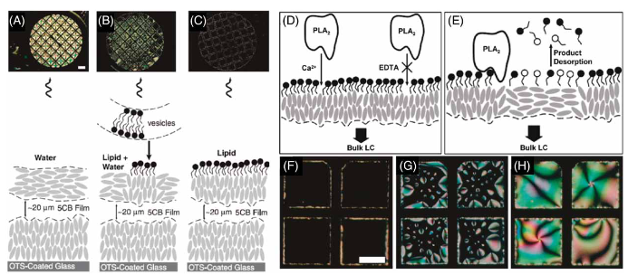
Chemical sensors
Carlton, R. J., Hunter, J. T., Miller, D. S., Abbasi, R., Mushenheim, P. C., Tan, L. N., & Abbott, N. L. (2013). Chemical and biological sensing using liquid crystals. Liquid crystals reviews, 1(1), 29-51.
Background context

Slide 21
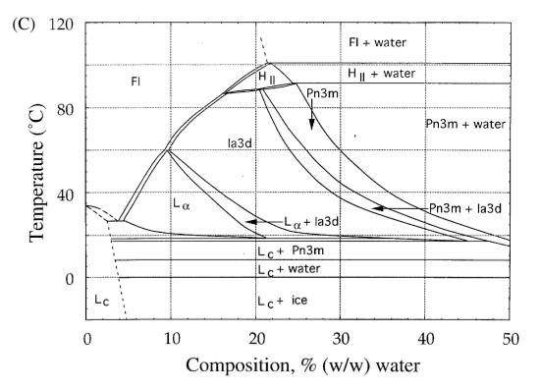
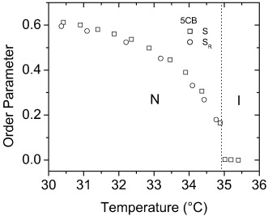
Families of liquid crystals
Thermotropic
Lyotropic
Pure molecular liquids – phase behaviour depends on temperature
Solutions of molecules – phase behaviour also depends on concentration
Luders, D. D., Oliveira, D. A., Kimura, N. M., Simões, M., & Palangana, A. J. (2015). Order parameter in the nematic–isotropic phase transition. J. Molecular Liquids, 207, 195-199.
Qiu, H., & Caffrey, M. (2000). The phase diagram of the monoolein/water system: metastability and equilibrium aspects. Biomaterials, 21(3), 223-234.

Slide 22
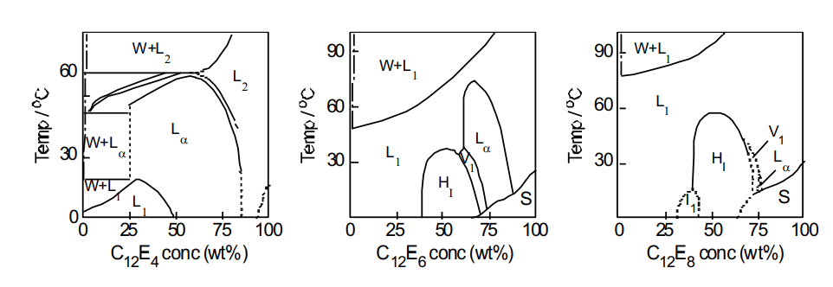
Lyotropic phase diagrams
Some examples of phase diagrams for non-ionic Surfactants.
Here C denotes a methylene group and E an oxyethylene group.
The dashed lines are approximate phase boundaries and the dot-dash line is the cmc
S=solid phase, W = aqeuous phase (containing unassociated surfactant)

Slide 23
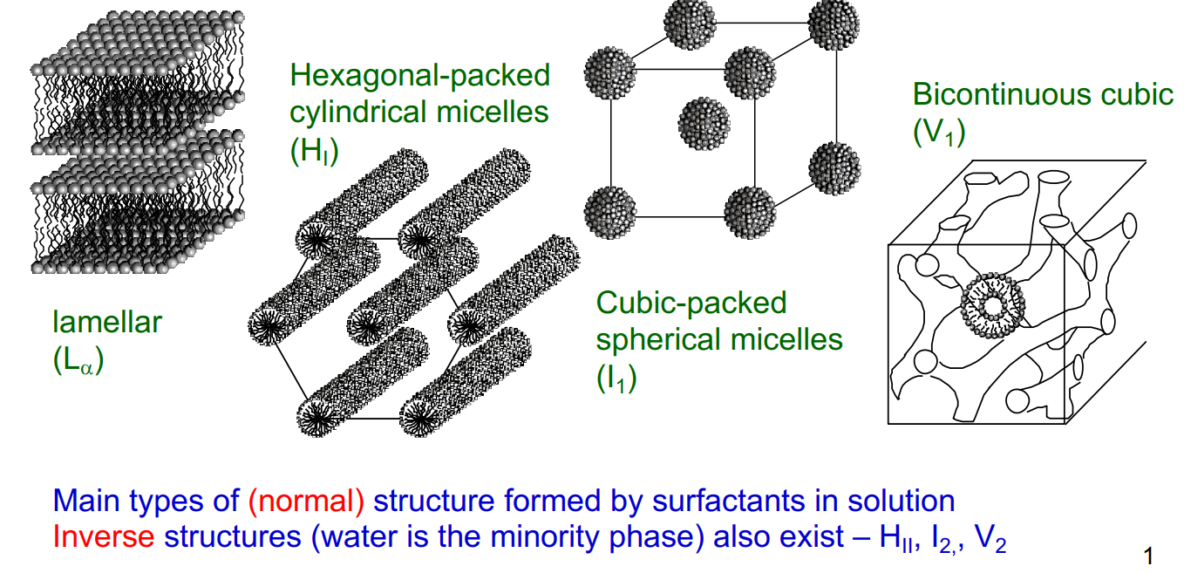
Lyotropic liquid crystals
At concentrations well above the cmc, surfactants can form lyotropic liquid crystal phases (and some are even thermotropic liquid crystals).
The phase formed depends on the concentration (hence the term lyotropic) and on the molecular structure.

Slide 24
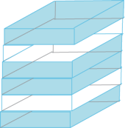
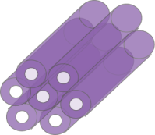
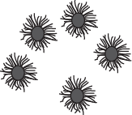
Lyotropic liquid crystals
At concentrations well above the cmc, surfactants can form lyotropic liquid crystal phases (and some are even thermotropic liquid crystals).
The phase formed depends on the concentration (hence the term lyotropic), temperature and on the molecular structure.
L_{α}
P
D
G
H_{II}
L₂

Slide 25
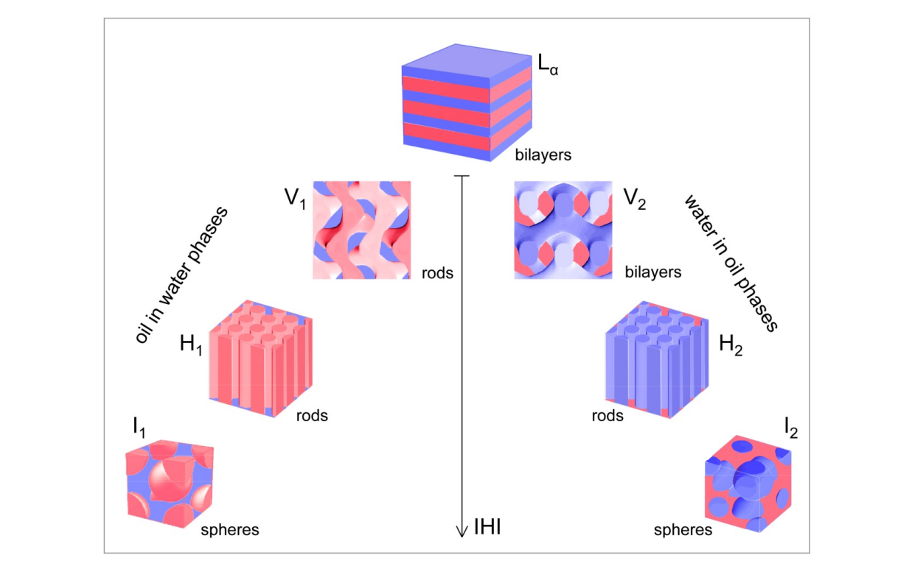

Inverse phases

Slide 26
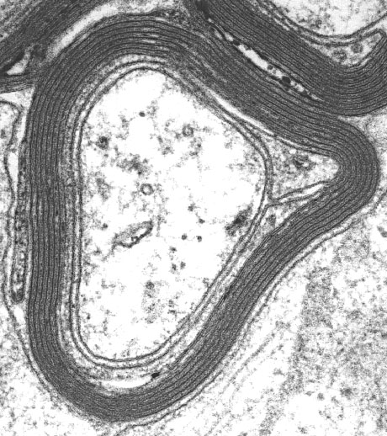
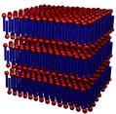
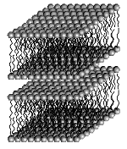
The lamellar phase
The fluid lamellar phase (L_{α})- can be thought of as a one-dimensional stack of bilayers.
Each bilayer, separated by a region of water is made up of molecules placed back to back producing two parallel planar polar interfaces.
In the L_{α} phase movement within the bilayer is not restricted as the alkyl chains are melted and fluid-like.
Water channel
Lipid bilayer
Water channel

Slide 27
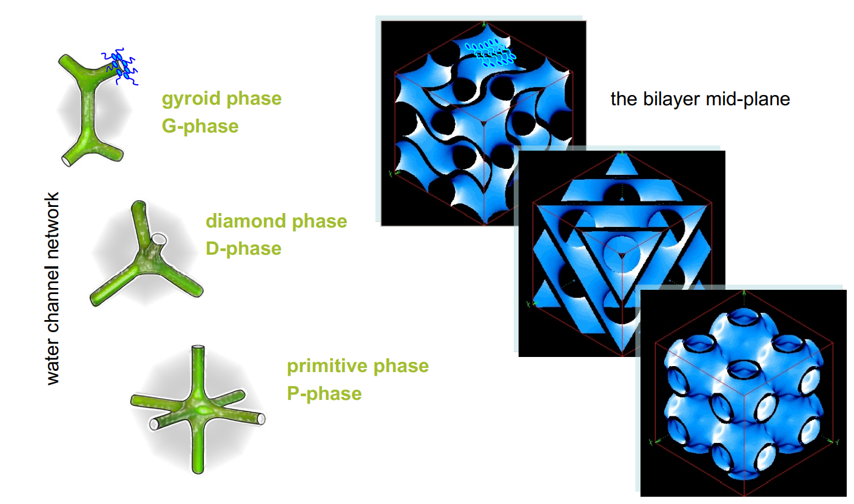
Bicontinuous phases
Single continuous bilayer which divides space into two inter-linked but separate aqueous sub-volumes.
Bilayer draped upon IPMSs (Infinite Periodic Minimal Surfaces)

Slide 28
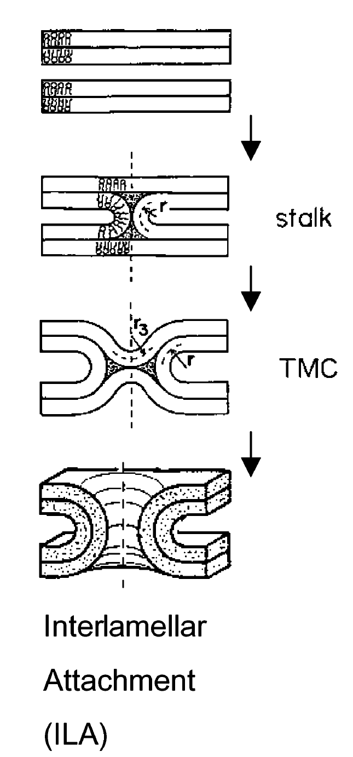
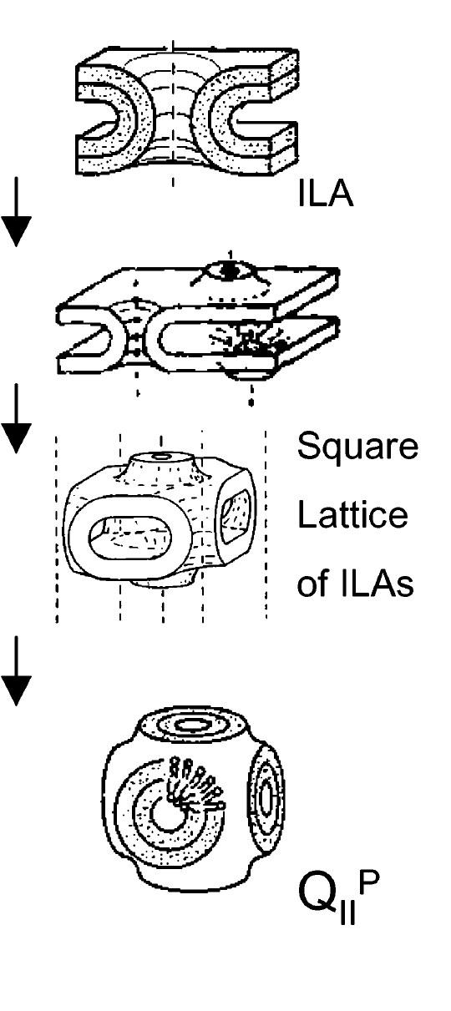
Biological relevance
Lamellar phase
Evidence suggesting complex lyotropic structures such as the inverse bicontinuous cubic phases form within cells and perform important biological functions
Membrane fusion and fission must eventually proceed via structural routes that must be closely similar to those which occur during lyotropic phase transitions
This is of central importance to our understanding of endo- and exocytosis
Bicontinuous cubic
phase
Studying membrane proteins in bicontinuous
phases is more “realistic” than in solution

Slide 29
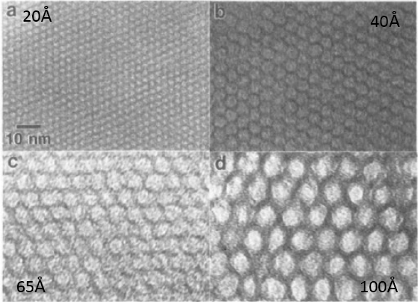
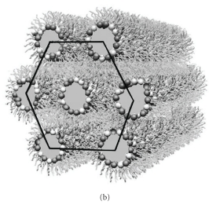
The hexagonal phase
The hexagonal phase can be visualised as a set of cylinders packed onto a 2-D hexagonal lattice.
This phase is often formed by lipids such as phosphatidylethanolamine (PE) which are present in high concentrations in cellular systems.
In the H_{II} phase cylinders of water (typically 10-20 Å in diameter) are surrounded by amphiphiles with lattice dimensions of the order of 50 to 90 Å
Implicated in membrane fusion

Slide 30
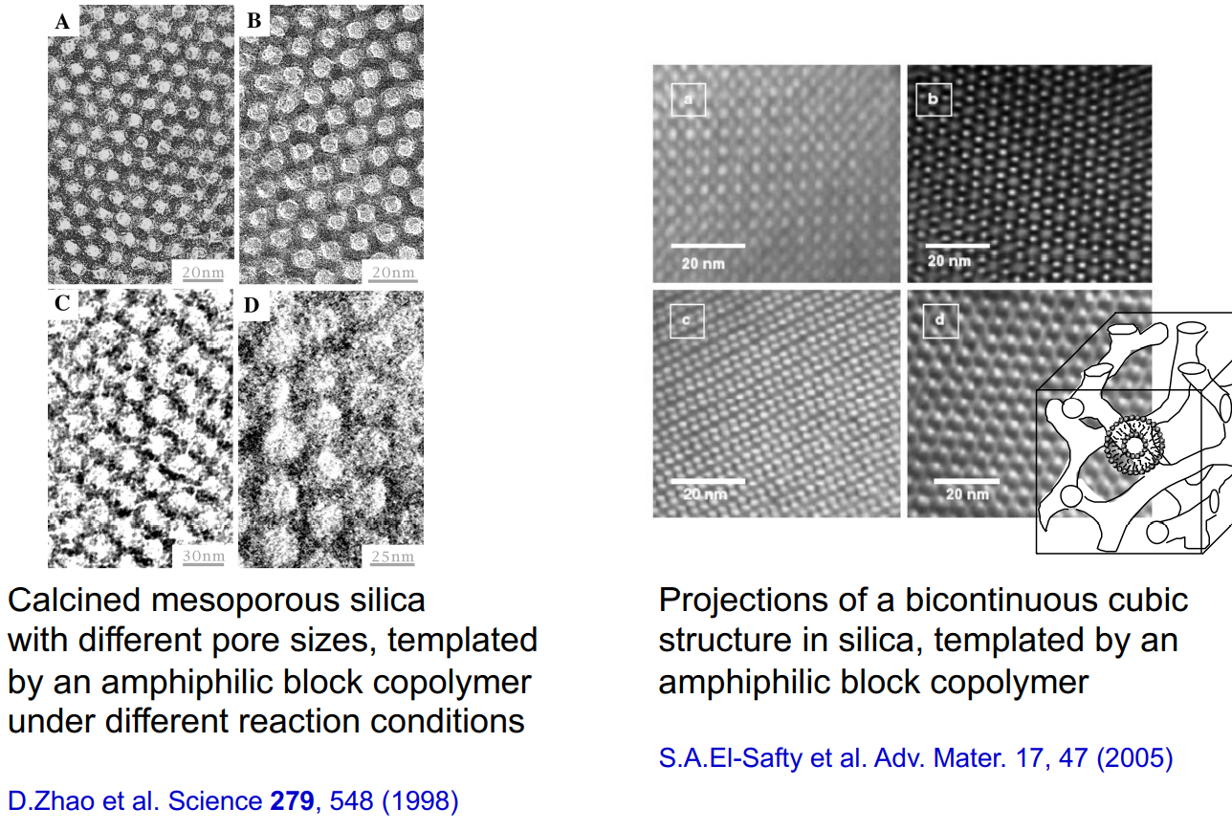
Templated lyotropic phases
A high-surface-area “mesoporous” material can be used in applications like catalysis and separations – pore size targets specific molecules

Slide 31
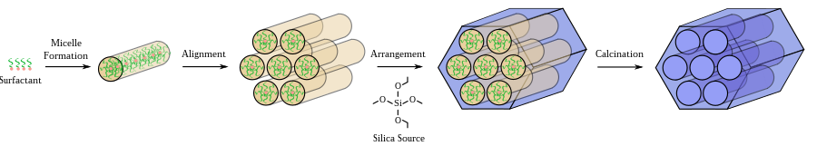
Templated lyotropic phases
Mechanisms of formation for “mesoporous” MCM-41 silica. Offers tunable pore size for targeting different molecules and widely used in catalysis, catalyst supports and separations

Slide 32
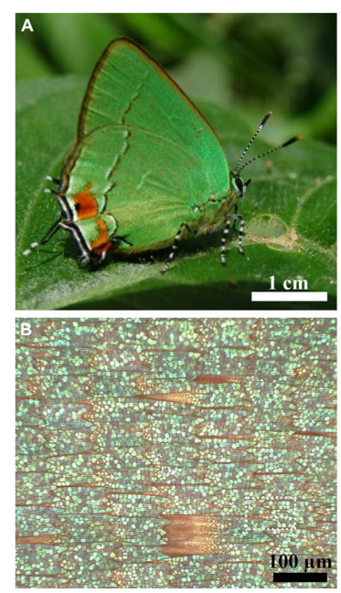
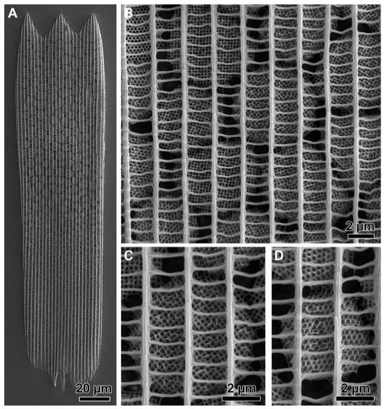
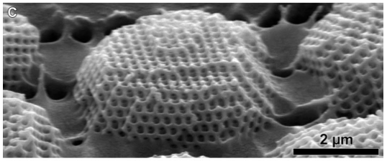
Templated lyotropic phases
Wilts, B. D., Apeleo Zubiri, B., Klatt, M. A., Butz, B., Fischer, M. G., Kelly, S. T., ... & Schröder-Turk, G. E. (2017). Butterfly gyroid nanostructures as a time-frozen glimpse of intracellular membrane development. Science advances, 3(4), e1603119.
Background context

Slide 33
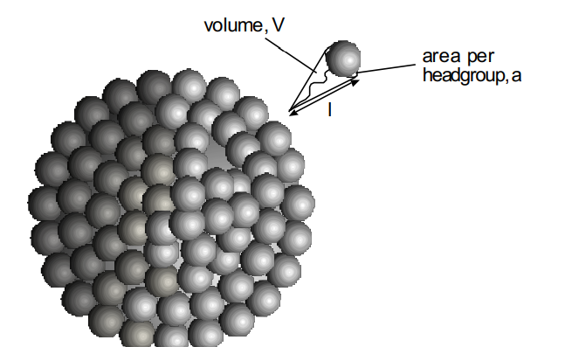
Lyotropic liquid crystals
The phase behaviour of amphiphiles can be rationalised on the basis of interfacial curvature.
This can be analysed using differential geometry (assuming a continuous surfactant “film” Or
on a molecular basis – molecular packing parameter model
Structure formed depends on the relative size of the hydrophobic tail and hydrophilic head-group.
The area per head group depends on the extent of hydration and therefore we refer to effective area per Headgroup.

Slide 34
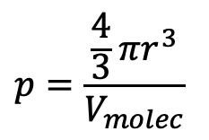
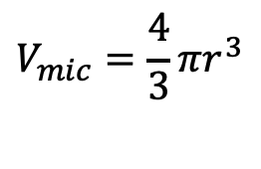
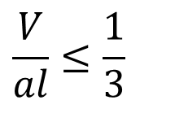
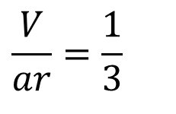
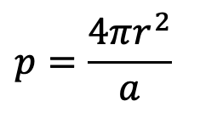
Lyotropic liquid crystals
We now define a packing parameter, N_{s}.
Consider the micellar association number, p.
For a spherical micelle, It can be written as the ratio of the micelle volume to the volume per molecule
$$V_{mic}=\frac{4}{3}πr^{3}$$
$$p=\frac{\frac{4}{3}πr^{3}}{V_{molec}}$$
The association number can similarly be calculated from the ratio of micellar area to the effective area per headgroup, a:
$$p=\frac{4πr^{2}}{a}$$
Equating the two expressions for p:
$$\frac{V}{ar}=\frac{1}{3}$$
Since r cannot exceed the length of a fully extended chain, l
LHS is the surfactant packing parameter
$$\frac{V}{al}≤\frac{1}{3}$$

Slide 35
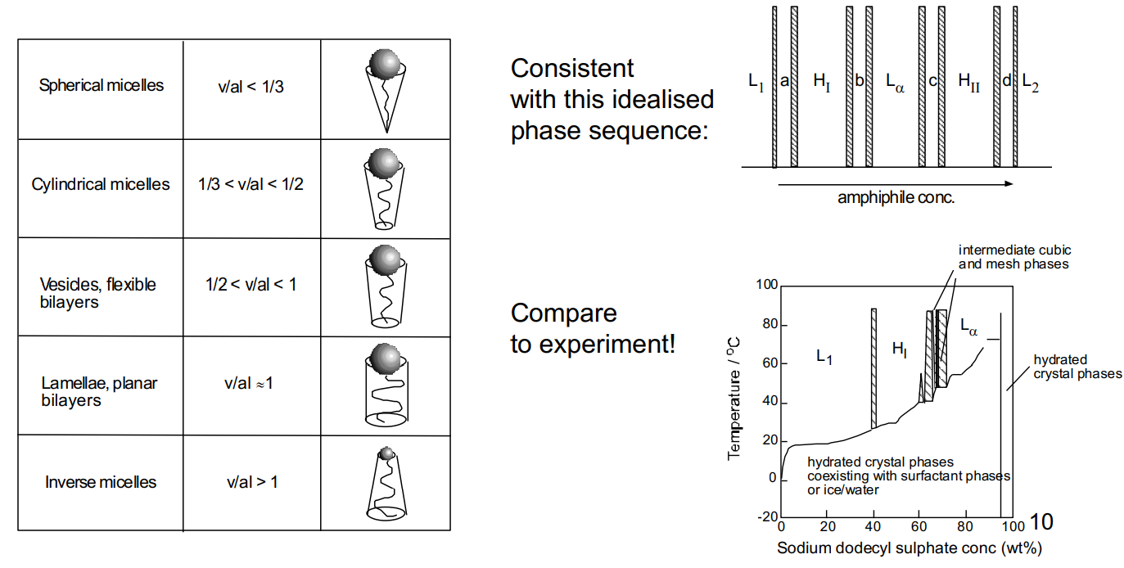
Lyotropic liquid crystals
The packing parameter depends on concentration, reflecting changes primarily in a, but also in V.
A similar calculation to that for spherical micelles, leads to the following sequences of inequalities for different aggregate shapes:

Slide 36
Lyotropic liquid crystals
L_{α}
P
D
G
H_{II}
L₂
Increasing negative curvature

Slide 37
Learning Outcomes
Today we have:
Understood the switching mechanism of liquid crystal displays
Described the different phase behaviour of thermotropic and lyotropic liquid crystals
Related the molecular packing parameter to different lyotropic liquid crystal phases.

Slide 38
Summary:
Surface and interfacial tension
Surfactancy
Gibbs adsorption isotherms
Micellization and surface activity
Critical micelle concentration as equilibrium
Thermodynamics of micellization
Liquid crystal phases

